Slide 1


Slide 2
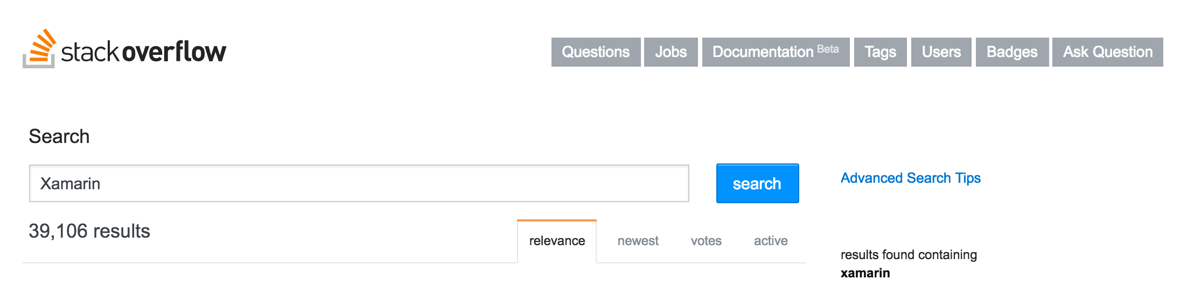

Slide 3
GOTCHA:
Memory management

Slide 4
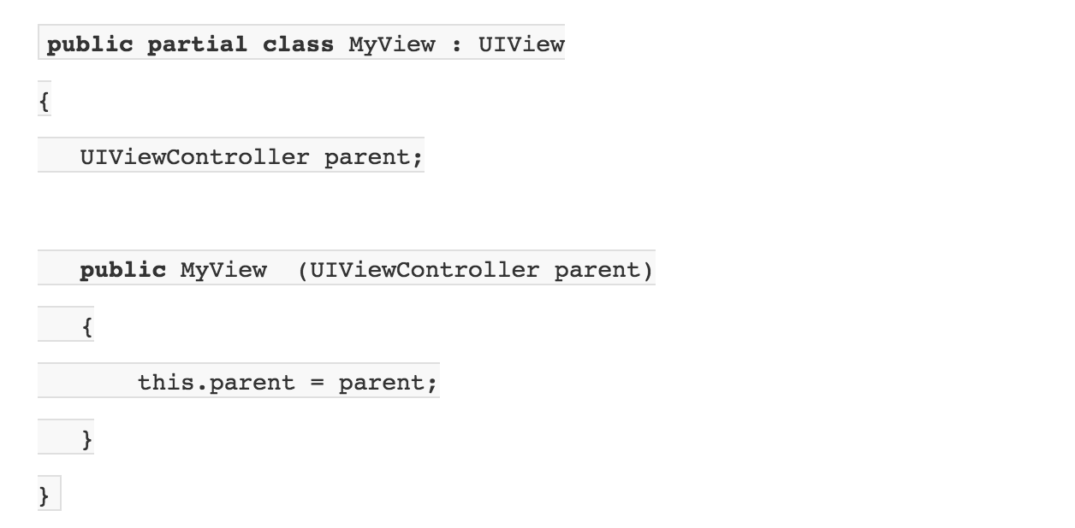
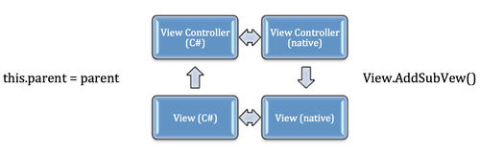

Slide 5
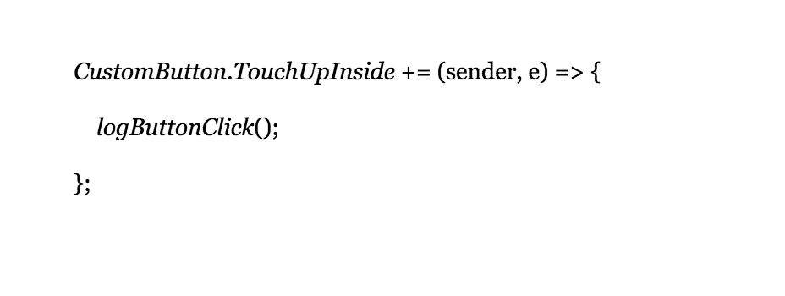

Slide 6
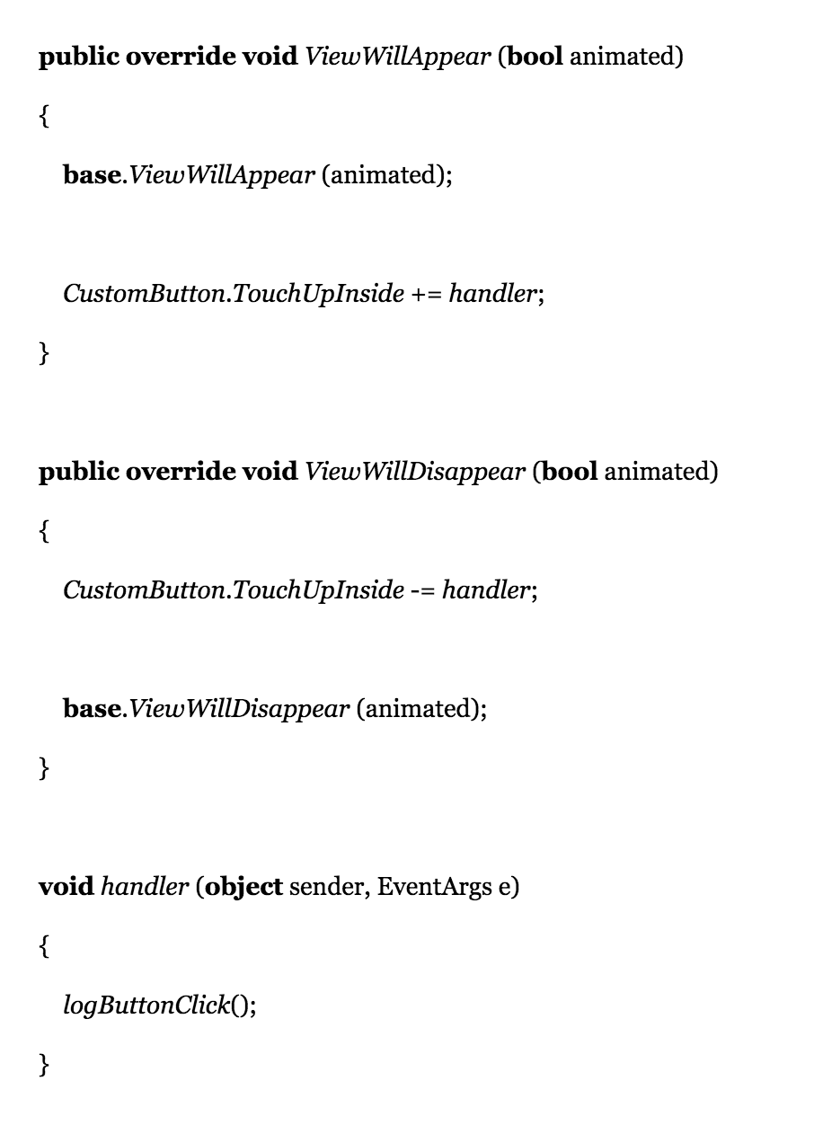

Slide 7
GOTCHA:
Signing

Slide 8
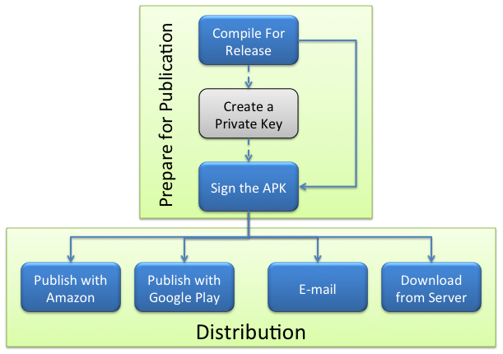

Slide 9
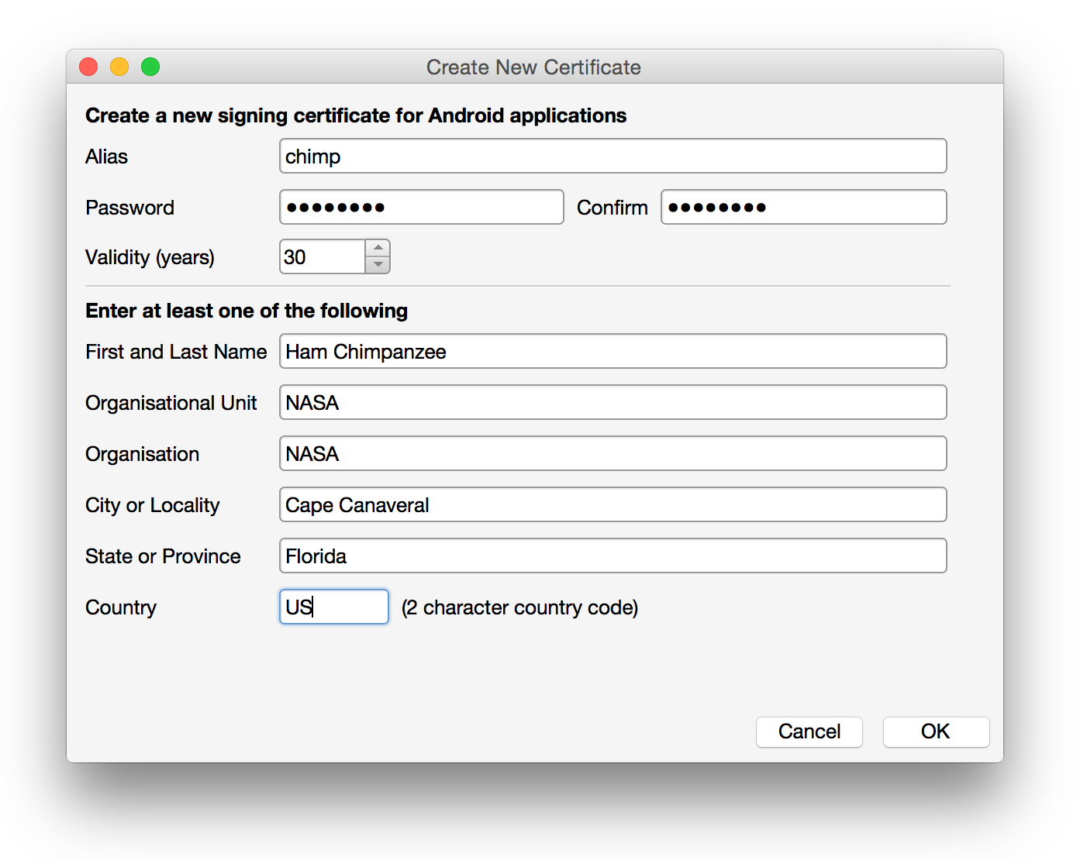

Slide 10
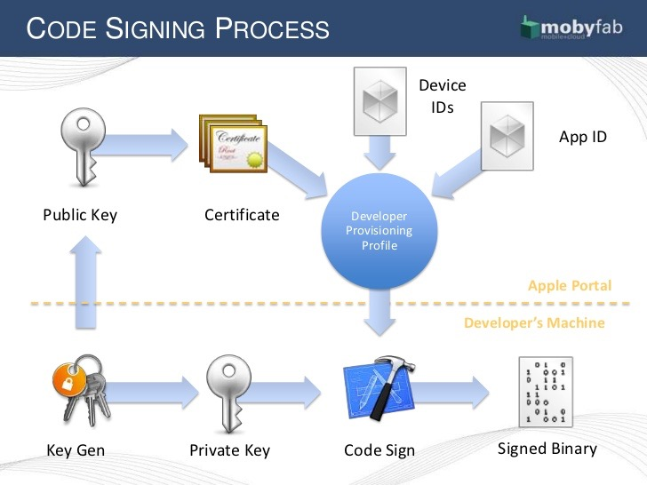

Slide 11


Slide 12
Interesting links
https://mvvmcross.com/
http://mvvmcross.blogspot.dk/
https://www.xamarin.com/university
https://github.com/snappdk/UCN

